Slide 1
Group 9 presentation
Edwine onyango- sct 221-0128/2017
Patronilla ndama- sct 221-0209/2017
Mike kipng’eno mutai- sct 221-0808/2016
Kibet enock –sct 221-0532/2017

Slide 2
Objectives
Explore the MYCIN knowledge based system
Introduction,
knowledge storage
Inferencing
Explore ALICE Chatbot
Introduction,
knowledge storage
Inferencing
Digital Neural Networks

Slide 3
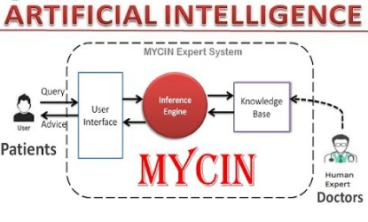
MYCIN
An expert system that uses AI to model physician patient interaction.
Identifies bacteria causing infection and recommends antibiotics.
It consists of the consultation system, explanation system and knowledge acquisition system. (Shortliffe et al., 1975)
How is information stored?
Knowledge base- rules and conditional statements
How the inference engine works?
Backward chaining- goal directed strategy.
Works from a desired goal
Consequent to antecedents
Determines if a set of facts supports this goals.

Slide 4
MYCIN knowledge base and inference engine in Mycin
#2 Again Substitute A for X in rule #1 which becomes
If X has headache and X has Chills, then X has high fever
#3 subdivide the antecedents/facts and determine if it matches the consequent.
Conclusion- patient A has
Is MYCIN intelligent? YES
Has knowledge acquisition system to generate new knowledge
Independent decision making
Was it applied in practice? No.
Reason- medical Ethics (ShortLiffe et al., 1975)
Facts/data- Patient A has Headache, patient A has Chills
Goal- determine is patient A has Malaria.
Knowledge Base
If X has headache and X has Chills then X has high fever
If X is vomiting and X has Diarrhoea then X has joint paints.
If X has high fever then X Then X has Malaria.
If X has joint paints, then X has Typhoid.
The inference engine develops diagnosis in four steps
#1- substitute X into rule 3.

Slide 5
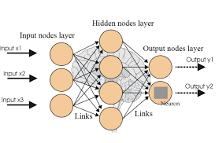
A digital drift of neural networks
Neural networks are a set of algorithms that are loosely modelled after the human brain that are designed to recognize pattern
Neural networks provide solutions to complex problems due to their nonlinear processing, parallel distributed architecture, self-organization, capacity of learning and generalization, and efficient hardware implementation.
Neural networks have a widespread number of application ,and these include ;
Digital communication , digital soil mapping ,speech recognition , character recognition ,speech recognition , signature verification and application , forecasting and predicting, signal processing , control and automation .

Slide 6
Challenges of neural networks
Hardware dependence
Unexplained behavior of the network
The challenges of neural networks in the present day science branch are being eliminated one at time through research .
This means that artificial neural networks atre becoming an indispensable part of our lives .

Slide 7
ALICE chatbot
ALICE- Artificial Linguistic Internet Computer Entity
Engages in a conversation with a human by applying some heuristical pattern matching rules to the human's input.
How is knowledge Stored?
Stored in AIML format with basic unit known as categories.
Each category entails question, output answer and optional context.
Inference in ALICE
Inference is done through forward chaining
Done through pattern matching using the search algorithms.
Is ALICE intelligent? YES
Did pass the Turing test.

